Slide 1

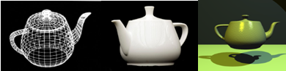
Introduction to Computer Graphics main concepts and methods - II
Universidade de Aveiro Departamento de Electrónica, Telecomunicações e Informática
(Wikipedia)
Beatriz Sousa Santos University of Aveiro, 2024

Slide 2
Topics
Computer Graphics main tasks
Geometric Primitives
Geometric transformations
2D and 3D visualization
Projections

Slide 3
CG Main Tasks
Modeling
Construct individual models / objects
Assemble them into a 2D or 3D scene (using transformations)
Rendering
Generate final images:
How is the scene illuminated?
What are the materials of the objects?
Where is the observer? How is he/she looking at the scene?
Animation
Static vs. dynamic scenes
Movement and / or deformation
3
Notes:
3

Slide 4
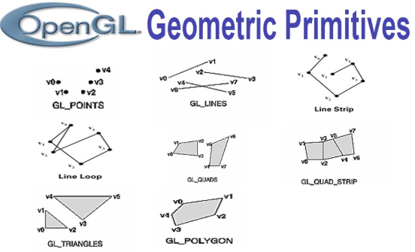
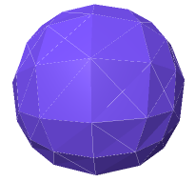
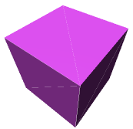

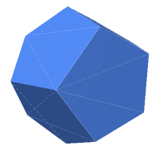
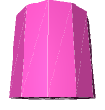
Geometric Primitives
Simple primitives Examples:
Points
Line segments
Polygons
Geometric primitives
Parametric curves / surfaces
Cubes, spheres, cylinders, etc.
https://threejs.org/manual/#en/primitives
Notes:
4
Three.js has a large number of primitives. Primitives are generally 3D shapes that are generated at runtime with a bunch of parameters.

Slide 5





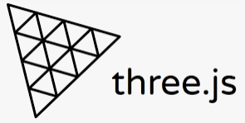

Computer Graphics APIs
Create 2D / 3D scenes from simple primitives
OpenGL and variants …
Rendering
No modeling or interaction facilities
Direct 3D – Microsoft
VTK
3D CG + Image processing + Visualization
Three.js
Vulkan …
Notes:
Direct3D is a graphics application programming interface (API) for Microsoft Windows. Part of DirectX, Direct3D is used to render three-dimensional graphics in applications where performance is important, such as games.
Three.js is a cross-browser JavaScript library and application programming interface (API) used to create and display animated 3D computer graphics in a web browser using WebGL. The source code is hosted in a repository on GitHub
Vulkan is the new generation, open standard API for high-efficiency access to graphics and compute on modern GPUs. This ground-up design, previously referred to as the Next Generation OpenGL Initiative, provides applications direct control over GPU acceleration for maximized performance and predictability.

Slide 6
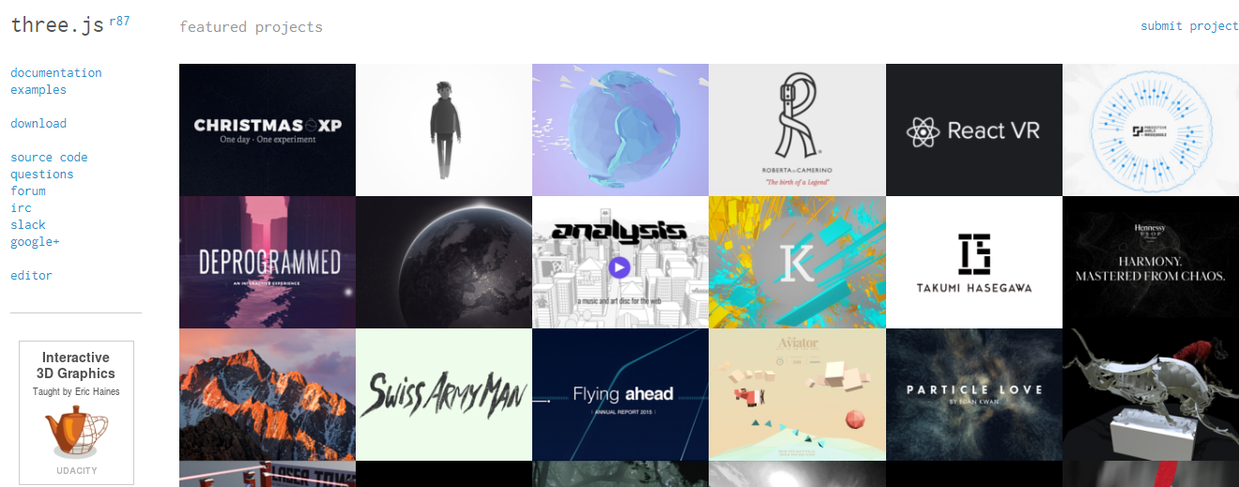
Three.js
Cross-browser JavaScript library/API used to create and display animated 3D computer graphics in a web browser.
Uses WebGL
https://threejs.org/
Notes:
http://www.larsberg.net/#/christmasExperiment
Three.js is a cross-browser JavaScript library and application programming interface used to create and display animated 3D computer graphics in a web browser using WebGL. The source code is hosted in a repository on GitHub

Slide 7
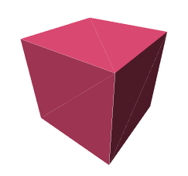
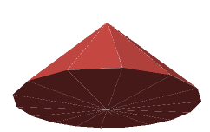
Geometric Primitives – three.js examples
const width = 8; // ui: width
const height = 8; // ui: height
const depth = 8; // ui: depth
const geometry = new THREE.BoxGeometry(width, height, depth);
const radius = 6; // ui: radius
const height = 8; // ui: height
const radialSegments = 16; // ui: radialSegments
const geometry = new THREE.ConeGeometry(radius, height, radialSegments);
const radius = 7; // ui: radius
const widthSegments = 12; // ui: widthSegments
const heightSegments = 8; // ui: heightSegments
const geometry = new THREE.SphereGeometry(radius, widthSegments, heightSegments);
https://threejs.org/manual/#en/primitives
Notes:
7
Three.js has a large number of primitives. Primitives are generally 3D shapes that are generated at runtime with a bunch of parameters.

Slide 8
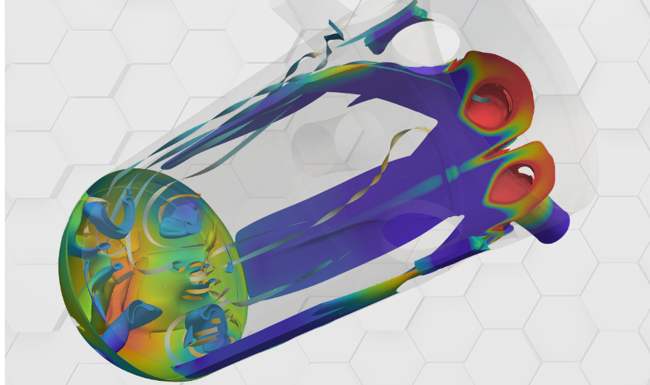
VTK
Open-source, freely available software system for 3D computer graphics, modeling, image processing, volume rendering, scientific visualization.
Is designed to be platform agnostic
https://vtk.org/
Notes:
https://examples.vtk.org/site/VTKBook/03Chapter3/
https://www.kitware.com/courses/vtk-beginner-course/
The Visualization Toolkit (VTK) is an open-source, freely available software system for 3D computer graphics, modeling, image processing, volume rendering, scientific visualization, and 2D plotting. It supports a wide variety of visualization algorithms and advanced modeling techniques, and it takes advantage of both threaded and distributed memory parallel processing for speed and scalability, respectively.
VTK is designed to be platform agnostic. This means that it runs just about anywhere, including on Linux, Windows, and Mac; on the Web; and on mobile devices.

Slide 9
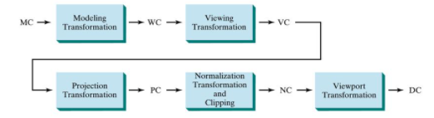
3D visualization pipeline (coordinate transformations)
MC - Modelling coordinates
WC – World coordinates
VC – Viewing coordinates
PC – Projection coordinates
NC – Normalized coordinates
DC – Display coordinates
(Hearn & Baker, 2004)
Notes:
Fiquei aqui na TP2 9/12
http://www.cs.utah.edu/~csilva/courses/cs5630/lec02.pdf
https://www.labri.fr/perso/nrougier/python-opengl/

Slide 10
2D and 3D visualization pipeline
We will start by 2D transformations and viewing a 2D scene and then generalize to 3D
Main operations represented as point transformations
Basic transformation matrices
Homogeneous coordinates
Matrix multiplication and composed transformations

Slide 11
Basic 2D Transformations
p = (x, y) → original point
p’ = (x’, y’) → transformed point
x
P =
y
Basic transformations:
- Translation
- Scaling
- Rotation
x’
P’ =
y’
Vector notation
Complex transformations may be expressed as a composition of these

Slide 12
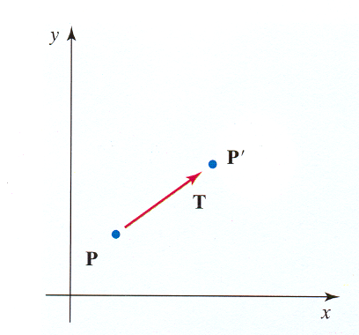
Translation
It is necessary to specify translations in x and y
x’ = x + tx
y’ = y + ty
x
P =
y
x’
P’ =
y’
tx
T =
ty
P´ = P + T
transformation matrix

Slide 13
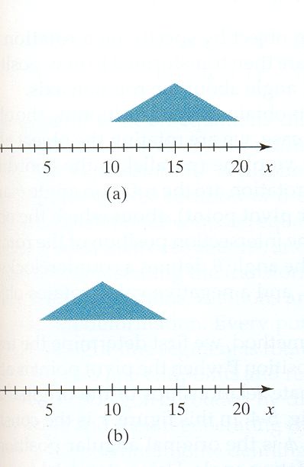
Translation
It is a rigid body transformation (it does not deform the object)
- To apply a translation to a line segment we need only to transform the end points
- To apply a translation to a polygon we need only to transform the vertices
(Hearn & Baker, 2004)

Slide 14
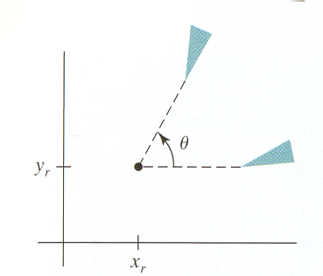
Rotation
To apply a 2D rotation we need to specify:
a point (center of rotation)
(x_{r} , y_{r} )
a rotation angle θ (the convention is: positive -> counter- clockwise)
- the simplest case is a rotation around the origin (0,0)
Positive rotation

Slide 15
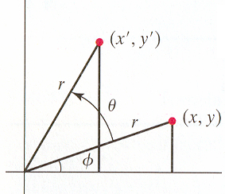
Rotation around the origin
The simplest case:
x’= r cos (Φ + Θ) = r cos Φ cos Θ – r sin Φ sin Θ
y’= r sin (Φ + Θ) = r cos Φ sin Θ + r sin Φ cos Θ
Polar coordenates of the original point:
x = r cos Φ
y = r sin Φ
Replacing:
x’ = x cos Θ – y sin Θ
y´ = x sin Θ + y cos Θ
r sin (Φ + θ)
r cos (Φ + θ)

Slide 16
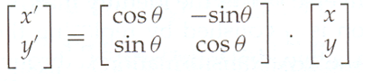

2D Rotation in matrix notation
x’= r cos (Φ + Θ) = r cos Φ cos Θ – r sin Φ sin Θ
y’= r sin (Φ + Θ) = r cos Φ sin Θ + r sin Φ cos Θ
r sin (Φ + θ)
Reminder:
cos(α+β) = cos α cos β − sin α sin β
cos (α−β) = cos α cos β + sin α sin β
r cos (Φ + θ)

Slide 17
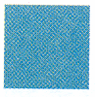
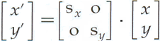
Scaling
Modifies the size of an object; we need to specify scaling factors: s_{x} and s_{y}
x’ = x . s_{x}
y’ = y . s_{y}
Trasformation matrix
Transforming a square into a larger square applying a scaling s_{x}=2, s_{y}=2
P’ = S . P
(Hearn & Baker, 2004)

Slide 18
2D Transformations (composed)
Matrix representation
Homogeneous coordinates !!
Concatenation = Matrix products
Complex transformations ?
Decompose into a sequence of basic transformations

Slide 19
Homogeneous coordinates
Most applications involve sequences of transformations
For instance:
- visualization transformations involve a sequence of translations and rotations to render an image of a scene
- animations may imply that an object is rotated and translated between two consecutive frames
Homogeneous coordinates provide an efficient way to represent and apply sequences of transformations

Slide 20
It is possible to combine in a matrix the multiplying and additive terms if we use 3x3 matrices
All transformations may be represented by multiplying matrices in homogenous coordinates
Each point is now represented by 3 coordinates
( x, y ) → (x_{h}, y_{h}, h), h = 0
x = x_{h} / h y = y_{h} / h
( x.h, y.h, h)
The simplest way: h=1 !

Slide 21
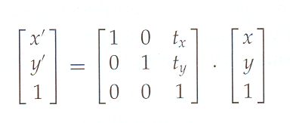

2D Translation (in homogeneous coordinates)
One more row and column
(but not many more operations…)
(Hearn & Baker, 2004)
Now, translation is applied by matrix multiplication

Slide 22
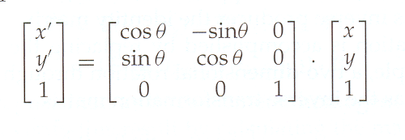
2D Rotation around (0,0) (in homogeneous coordinates)
x’= r cos (Φ + Θ) = r cos Φ cos Θ – r sin Φ sin Θ
y’= r sin (Φ + Θ) = r cos Φ sin Θ + r sin Φ cos Θ
r sin (Φ + θ)
r cos (Φ + θ)

Slide 23
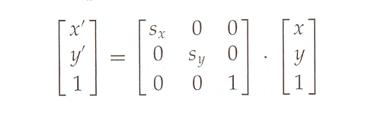

2D Scaling (in homogeneous coordinates)
(sx = sy)
- Now all basic transformations are applied by multiplication!
- We may concatenate multiple matrices
(sx ≠ sy)
(Hearn & Baker, 2004)

Slide 24
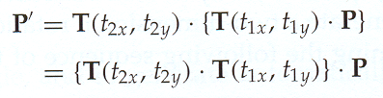
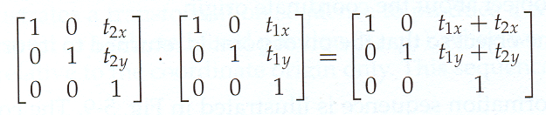

Concatenation of two translations

Slide 25
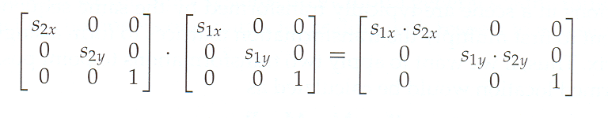
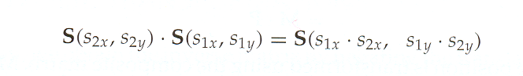
Concatenation of two scaling transformations

Slide 26
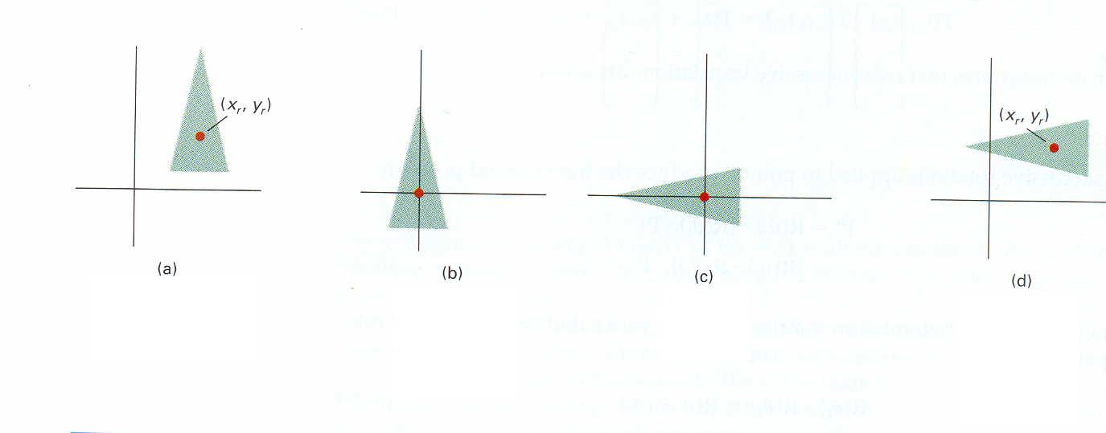
Arbitrary Rotation (around any point)
(Hearn & Baker, 2004)
Translation + Rotation + Inverse Translation
(to the origin) (around the origin) (to the initial position)
Notes:
Começar aqui na TP3 a 9/12/2024

Slide 27
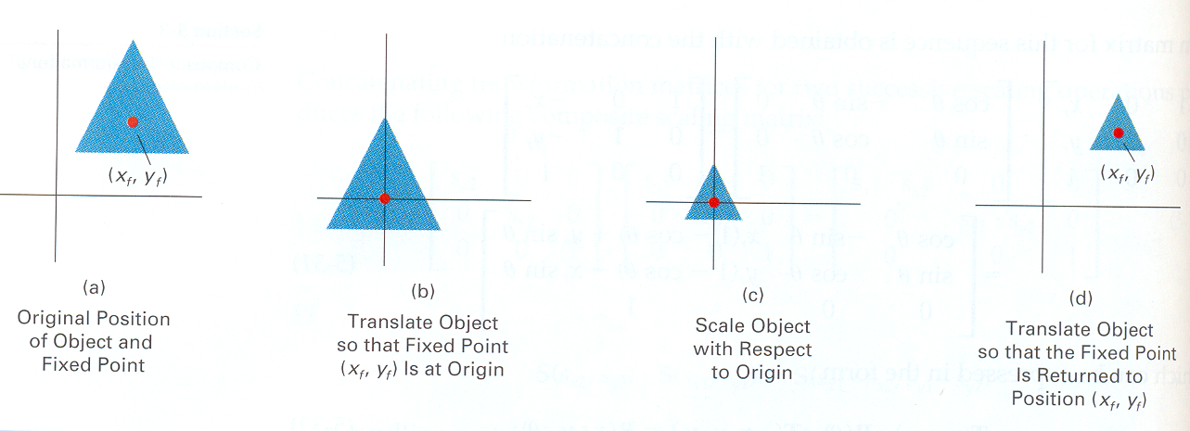
Arbitrary Scaling
(Hearn & Baker, 2004)
Translation + Scaling + Inverse Translation

Slide 28
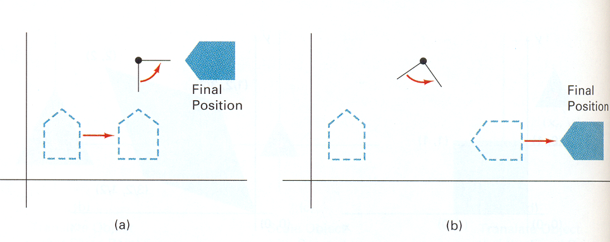
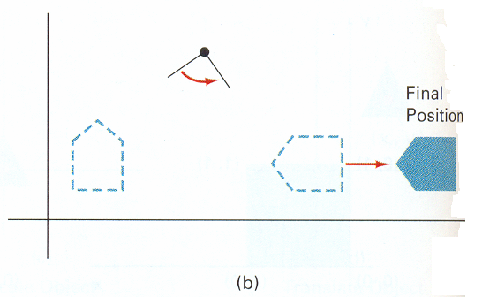
Order is important !
a) Translation + rotation b) Rotation + translation
(Hearn & Baker, 2004)
Results may be different if transformations are applied in a different order!

Slide 29
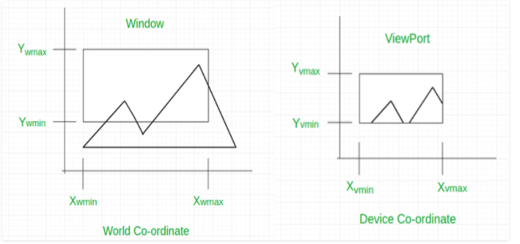
The case of viewing 2D scenes
Define a 2D scene in the world coordinate system
Select a clipping window in the XOY plane
The window contents will be displayed
Select a viewport in the display
The viewport displays the contents of the clipping window
Note: Clipping window and viewport are the traditional terms in CG
window-to-viewport-transformation-in-computer-graphics-with-implementation/
29

Slide 30
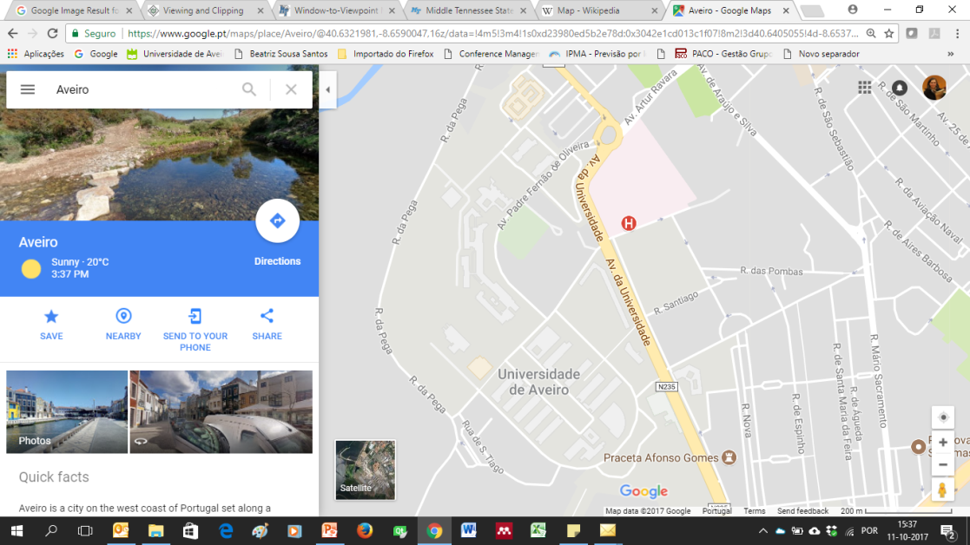

Viewport
World ---> display
y
Clipping Window
yw
Display Coordinates x
World Coordinates xw

Slide 31
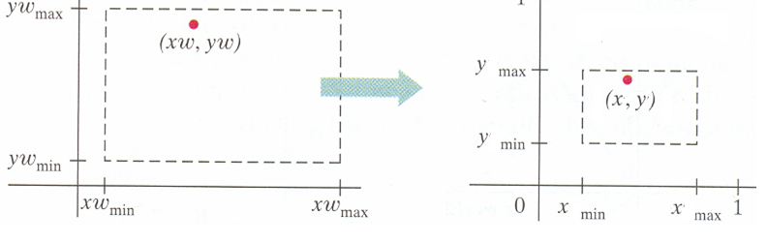
Coordinate mapping
Clipping Window
Viewport
World Coordinates Screen coordinates
(Hearn & Baker, 2004)
Objects inside the clipping window are mapped to the viewport (the area on the screen where they will be displayed).
Home work:
Compute (x,y) given (xw, yw)
Notes:
Fiquei aqui na TP2 a 2/Dez e na TP1 a 4

Slide 32
Coordinate mapping
Clipping Window
Viewport
World Coordinates Screen coordinates
(x,y) given (xw, yw) :
xw – xwmin = x – xmin
xwmax – xwmin xmax - xmin
yw – ywmin = y – ymin
ywmax – ywmin ymax - ymin
Notes:
https://www.geeksforgeeks.org/window-to-viewport-transformation-in-computer-graphics-with-implementation/#:~:text=Window%20to%20Viewport%20Transformation%20is,are%20mapped%20to%20be%20displayed.

Slide 33
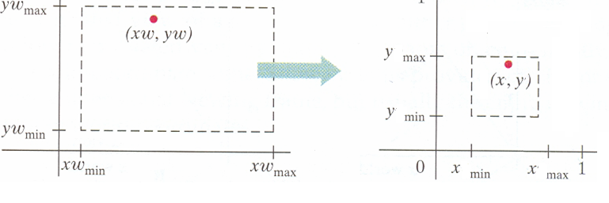
Coordinate mapping
If the aspect ratio is not the same in both situations the result is distortion
(Hearn & Baker, 2004)

Slide 34

World -> screen
y
y
Screen Coordinates x
The aspect ratio is not the same in x and y: distortion!
World Coordinates x

Slide 35
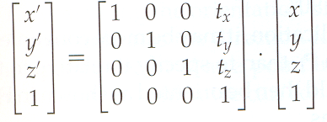
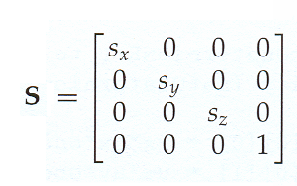
3D Transformations (in homogeneous coordinates)
Translation
Scaling
x
P = y
z
x’
P’ = y’
z’
A 3D point in vector notation

Slide 36
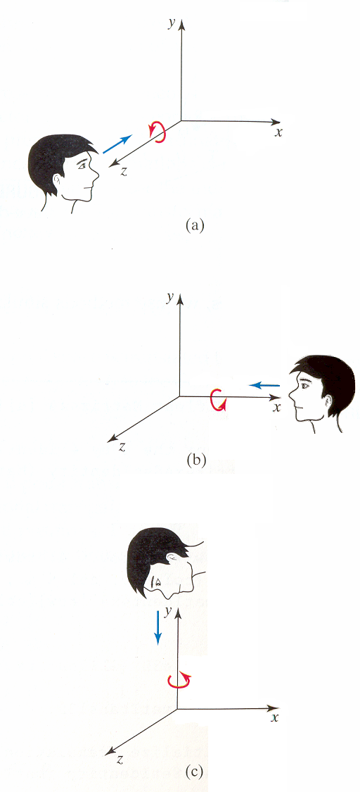
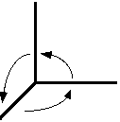
3D Rotation (in homogeneous coordinates)
Rotation around each one of the coordinate axis
Positive rotations are CCW (counter clock wise)!!
y
x
z
3D coordinate system in CG
(Hearn & Baker, 2004)

Slide 37
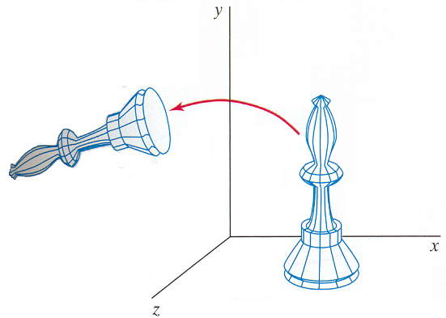
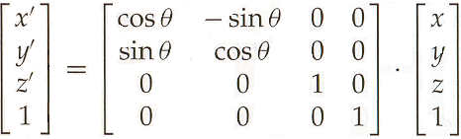
Rotation around ZZ’
The z coordinate is maintained

Slide 38
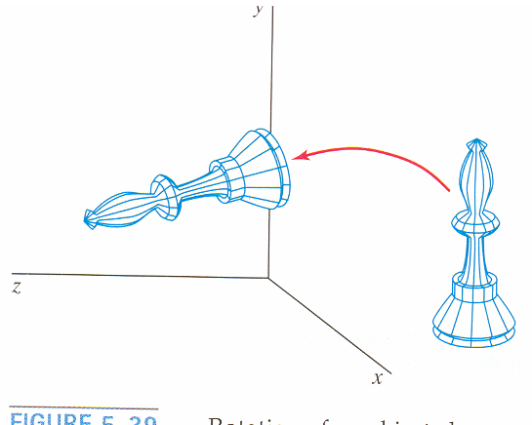
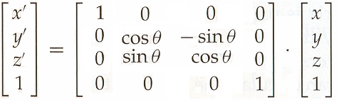
Rotation around XX’
(Hearn & Baker, 2004)

Slide 39
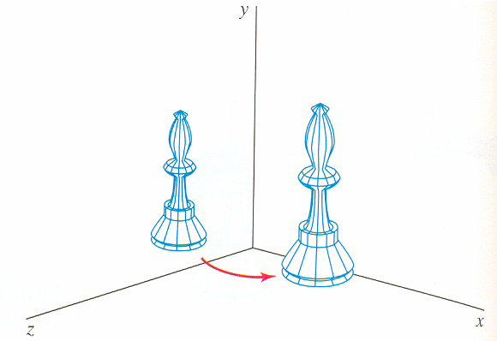
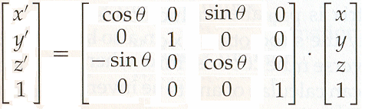
Rotation around YY’
(Hearn & Baker, 2004)

Slide 40
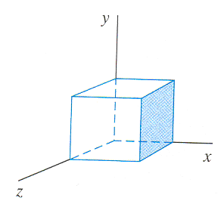
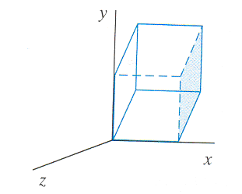
Other useful 3D Transformations
Shears
Reflections
Shear in ZZ’

Slide 41
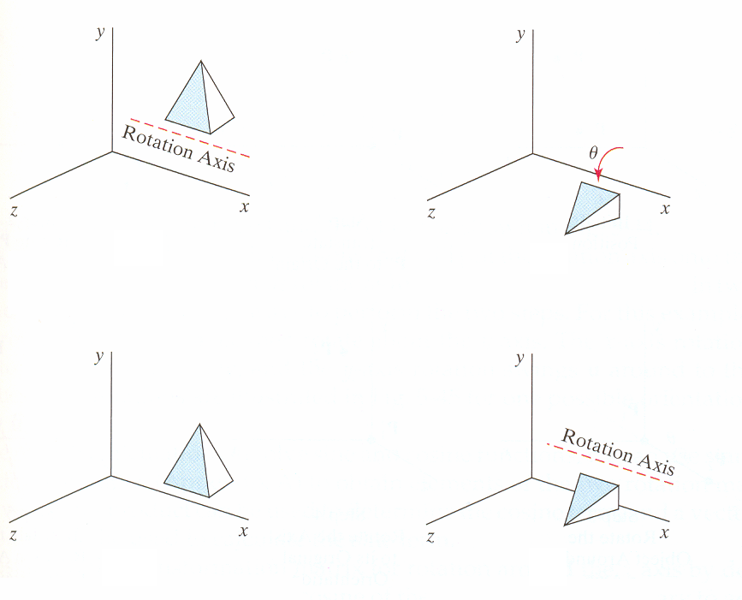

Slide 42
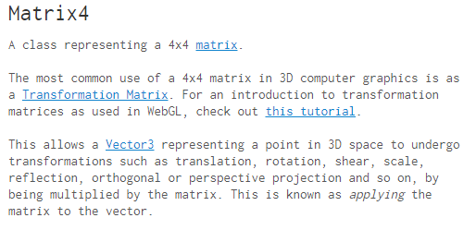
Transformations in three.js
https://threejs.org/docs/#api/math/Matrix4

Slide 43
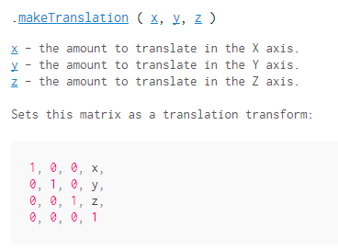
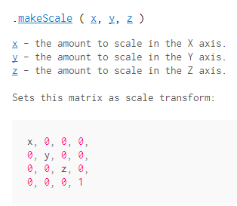

Slide 44




Slide 45



3D Viewing
(Hearn & Baker, 2004)

Slide 46

Camera specification
Position and orientation
Lens
Image size
Orientation of image plane
(Angel, 2012)

Slide 47
3D Viewing (2D representation of a 3D scene)
Where is the observer / the camera ?
Position ?
Close to the 3D scene ?
Far away ?
How is the camera/observer looking at the scene ?
Orientation ?
How to represent as a 2D image ?
Projection ?

Slide 48
3D visualization pipeline
Instantiate models of the scene
Position, orientation, size
Establish viewing parameters
Camera position and orientation
Compute illumination and shade polygons
Perform clipping
Project into 2D
Rasterize

Slide 49


Projection (from 3D to 2D)
2D representations of a 3D scene may be done in different ways (in CG
geometric planar projections are used: straight projectors/planar viewing plane)
Parallel Projection Perspective Projection
(allows measures) (more realistic images)
https://www.britannica.com/science/projection-geometry

Slide 50

Planar geometric projections
https://www.javatpoint.com/computer-graphics-projection

Slide 51



Projections
Parallel projectors (projection center at infinity)
projection center
Examples of resulting representation on the viewing plane
Parallel Projection Perspective Projection
(Hearn & Baker, 2004)
Notes:
Fiquei aqui na TP2 – 19/12/22

Slide 52


Parallel Projections
Orthographic / Axonometric projection
Oblique projection
Orthographic/ Multiview projection
(Hearn & Baker, 2004)

Slide 53

Parallel projections are widely used in architecture
Front elevation
Floor plan
Allowing distance
measures
https://www.cadpro.com/easy-home-building-floor-plan-software/

Slide 54


Perspective Projections
Foreshortening indicates a perspective projection
Approximate representation as a scene is seen by the eye
Object's dimensions along the line of sight appear shorter than its dimensions across the line of sight
https://en.wikipedia.org/wiki/Perspective_(graphical)
Notes:
Linear perspective is an approximate representation, generally on a flat surface, of an image as it is seen by the eye. The most characteristic features of linear perspective are that objects appear smaller as their distance from the observer increases, and that they are subject to foreshortening, meaning that an object's dimensions along the line of sight appear shorter than its dimensions across the line of sight. All objects will recede to points in the distance, usually along the horizon line, but also above and below the horizon line depending on the view used.

Slide 55


Perspective Projections
One vanishing point perspective projection
Two vanishing points perspective projection
(Hearn & Baker, 2004)
Notes:
https://vivadifferences.com/difference-between-parallel-and-perspective-projection-in-computer-graphics/

Slide 56


Orthographic vs perspective camera in Three.js

Slide 57
How to represent/apply projections?
Projection matrices
Homogeneous coordinates
Concatenation through matrix multiplication
Don’t worry !
Graphics APIs implement usual projections !

Slide 58



How to apply Projections?
Also by matrix multiplication
Example: Matrix of the orthographic projection on the xy plane in homogeneous coordinates:
zz coordinates are discarded
y
z
x

Slide 59

Example of a more complex projection matrix
Compute the matrix to obtain a view allowing to make measures on the triangle face of the object.
The vertices of the face are:
P₁ = (1, 0.5, 1)
P₂ = (0.5, 1, 1)
P₃ = (1, 1, 0.5)
P₂
P₃
Hint:
- What is the type of projection that allows to make measures?
- Find the rotations needed …
P₁

Slide 60

Resulting matrix:
2/√6 -1/ √6 -1/ √6 0
0 1/ √2 -1/ √2 0
0 0 0 0
0 0 0 1
M _{final} =

Slide 61


How to limit what is observed and represented ?
Clipping window on the projection plane
View volume (frustum) in 3D
Far Clipping plane
Clipping window
Near Clipping plane
(Hearn & Baker, 2004)
Parallel projection Perspective projection

Slide 62
Examples using Three.js
https://threejs.org/
Notes:
http://www.larsberg.net/#/christmasExperiment
Three.js is a cross-browser JavaScript library and application programming interface used to create and display animated 3D computer graphics in a web browser using WebGL. The source code is hosted in a repository on GitHub

Slide 63

Projections
https://threejs.org/examples/#webgl_camera

Slide 64

Clipping (and shadows)
https://threejs.org/examples/#webgl_clipping

Slide 65
Thee.js first example
1. Defining the scene, the camera and where the scene is rendered
var scene = new THREE.Scene();
var camera = new THREE.PerspectiveCamera( 75, window.innerWidth / window.innerHeight, 0.1, 1000 );
var renderer = new THREE.WebGLRenderer();
renderer.setSize( window.innerWidth, window.innerHeight );
document.body.appendChild( renderer.domElement );
Notes:
TThere are a few different cameras in three.js. For now, let's use a PerspectiveCamera.
The first attribute is the field of view. FOV is the extent of the scene that is seen on the display at any given moment. The value is in degrees.
The second one is the aspect ratio. You almost always want to use the width of the element divided by the height, or you'll get the same result as when you play old movies on a widescreen TV - the image looks squished.
The next two attributes are the near and far clipping plane. What that means, is that objects further away from the camera than the value of far or closer than near won't be rendered. You don't have to worry about this now, but you may want to use other values in your apps to get better performance.

Slide 66
2.Creating an object and camera position
var geometry = new THREE.BoxGeometry(1,1,1);
var material = new THREE.MeshBasicMaterial( { color: 0x00ff00 } );
var cube = new THREE.Mesh( geometry, material );
scene.add( cube );
camera.position.z = 5;

Slide 67
3. Scene rendering
function render() {
requestAnimationFrame(render);
renderer.render(scene, camera);
}
render();
cube.rotation.x += 0.1;
cube.rotation.y += 0.1;
4. Scene animation

Slide 68
Adding lights and shading
var material = new THREE.MeshPhongMaterial({
ambient: '#006063',
color: '#00abb1',
specular: '#a9fcff',
shininess: 100
});

Slide 69


Examples in three.js (with code)
Orthogonal camera;
Ambient light + direction light; Lambertian objects
https://threejs.org/examples/#canvas_camera_orthographic

Slide 70

…
(uses orthographic projection)
…

Slide 71

…
…

Slide 72
Some reference books
S. Marschner, P. Shirley, Fundamentals of Computer Graphics, 5th ed., A K Peters/CRC Press, 2021
Fundamentals of Computer Graphics, 5th Edition (oreilly.com)
D. Hearn and M. P. Baker, Computer Graphics with OpenGL, 3rd Ed., Addison-Wesley, 2004
E. Angel and D. Shreiner, Introduction to Computer Graphics, 6th Ed., Pearson Education, 2012
Hughes, J., A. Van Dam, et al., Computer Graphics, Principles and Practice, 3rd Ed., Addison Wesley, 2013
Hughes/Computer Graphics, 3/E (oreilly.com)

